Slide 1

2012年营业部上半年工作总结
Automatic Labeling of Topic Models
2012.7.20
高望
2018-6-8
1
PowerPoint Template Guidelines/2007

Slide 2
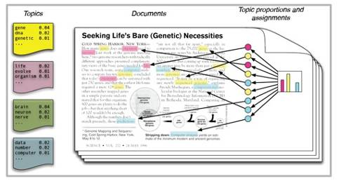
The interpretation of each topic is very important when people want to browse, understand and leverage the topic.
Top words in a topic-word distribution illustrate the sense of the topic.
2
MODEL
Notes:
However, it is usually very hard for a user to understand the discovered topics based only on the multinomial distribution of words.

Slide 3

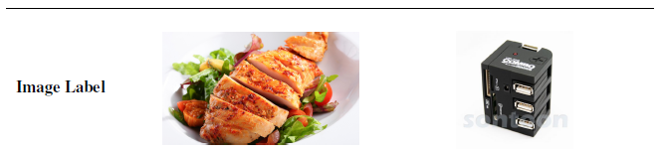
Automatic topic labelling methods aims to find phrases, images or summaries to assist with topic interpretation.
2
MODEL

Slide 4
1
1
Automatic labelling of topics with neural embeddings
2016 COLING
4
Notes:
借助向量表示生成主题的文本标签，具体的方法分为两个步骤

Slide 5

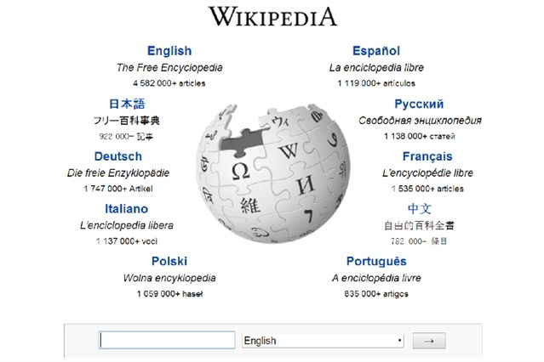
Step 1:
Candidate label generation based on Wikipedia
To match topics to Wikipedia articles, previous methods used an IR approach, by querying English Wikipedia with the top-N topic terms.
They required external resources (two search APIs, one of which is no longer publicly available)
2
MODEL
Automatic Labelling of Topics with Neural Embeddings, 2016, COLING
Notes:
However, in order to do this, they required external resources (two search APIs, one of which is no longer publicly available), limiting the general-purpose utility of the
method

Slide 6
Step 1:
Candidate label generation based on Wikipedia
Title embedding generation
This paper trains a doc2vec model on the English Wikipedia articles, and represent the embedding of a Wikipedia title by its document embedding
They also experiment with word2vec to generate embeddings for Wikipedia titles by treating titles as a single token
financial crisis financial_crisis
2
MODEL
Automatic Labelling of Topics with Neural Embeddings, 2016, COLING

Slide 7
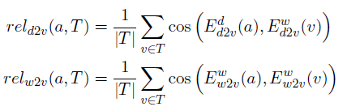
Step 1:
Candidate label generation based on Wikipedia
Given a topic, they measure the relevance of title embedding with word embeddings for the top-10 topic terms
2
MODEL
Automatic Labelling of Topics with Neural Embeddings, 2016, COLING

Slide 8
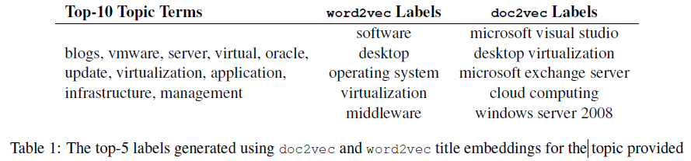
Step 1:
Candidate label generation based on Wikipedia
2
MODEL
1. doc2vec tends to favour fine-grained concepts
2. word2vec favours more generic or abstract labels
Automatic Labelling of Topics with Neural Embeddings, 2016, COLING

Slide 9
Step 2:
Re-rank based on a supervised learn-to-rank model
More features
LetterTrigram based on the finding of Kou et al. (2015).
the lettertrigram of the title of stock market is
{_st, sto, toc, ock, ck_, _ma, mar, ark, rke, ket, et_}
Rank the labels based on cosine similarity with topic words
2
MODEL
Automatic Labelling of Topics with Neural Embeddings, 2016, COLING
Notes:
The next step after candidate generation is to re-rank them based on a supervised learn-to-rank model, in an attempt to improve the quality of the top-ranking candidates

Slide 10
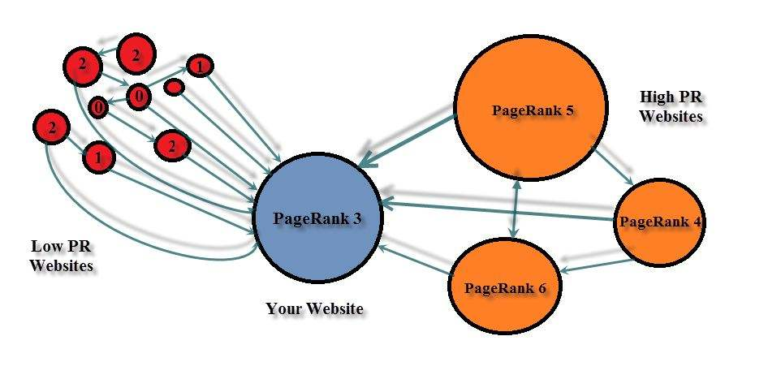
Step 2:
Re-rank based on a supervised learn-to-rank model
More features
PageRank to prefer labels which represent more “core” concepts in Wikipedia
NumWords
TopicOverlap
2
MODEL
Automatic Labelling of Topics with Neural Embeddings, 2016, COLING

Slide 11
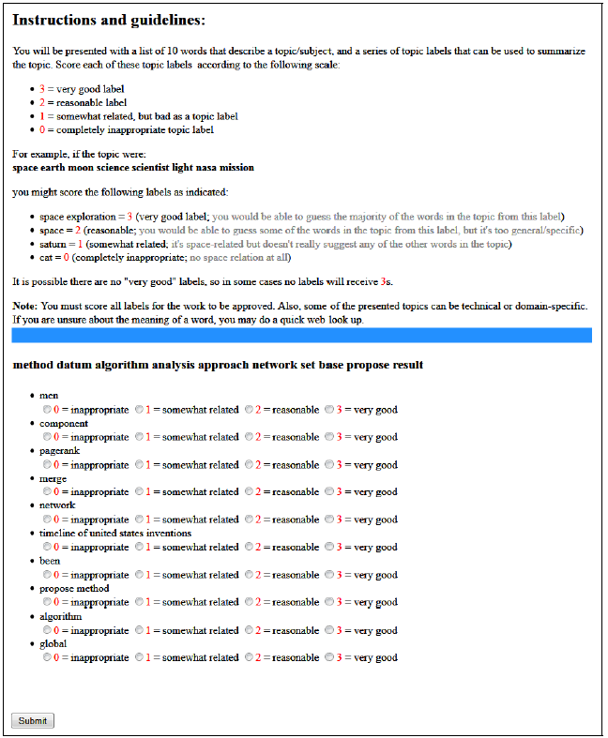
Experiments
They used CrowdFlower to collect human judgements
2
MODEL

Slide 12
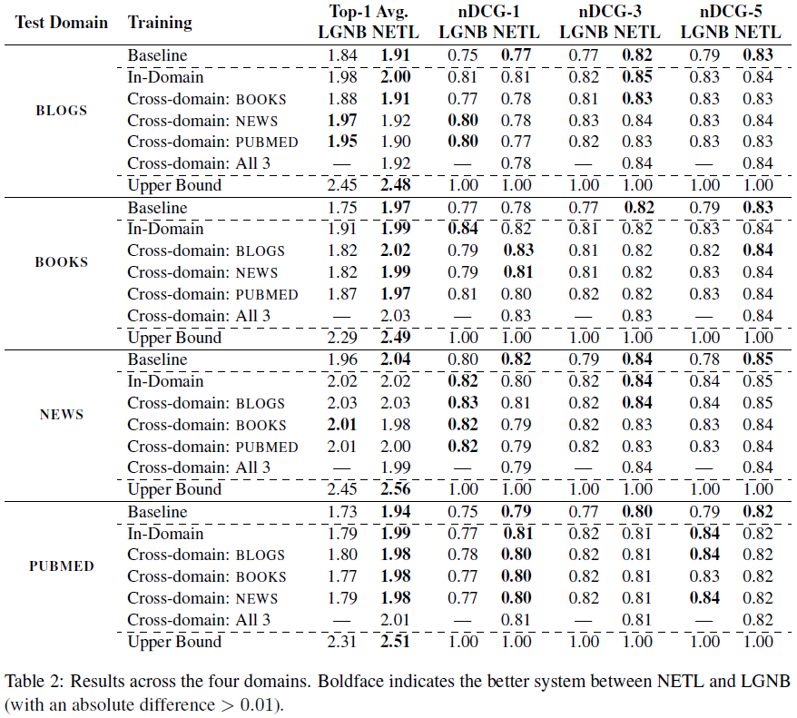
2
MODEL
Notes:
1.the supervised system improves over the unsupervised baseline
2.there is relatively little difference between the in-domain and cross-domain results for our method

Slide 13
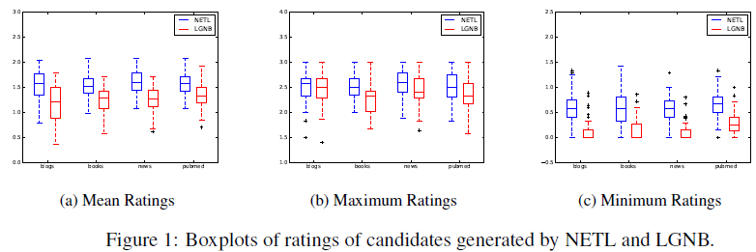
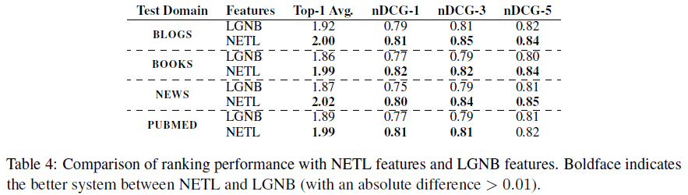
2
MODEL
Automatic Labelling of Topics with Neural Embeddings, 2016, COLING

Slide 14
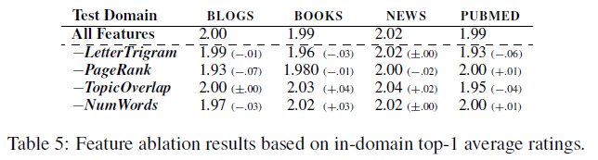
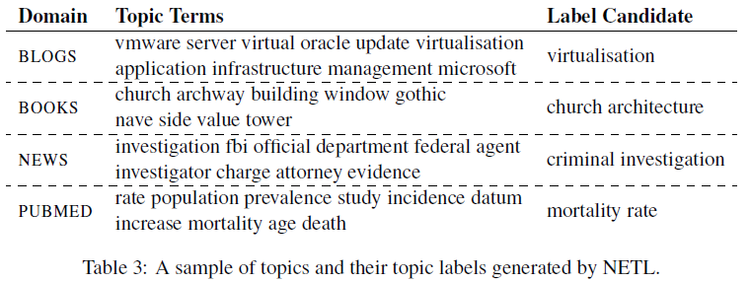
2
MODEL
Automatic Labelling of Topics with Neural Embeddings, 2016, COLING
Notes:
主题：主题词个数；权重；维基百科标题：关键词提取；维基图结构特征研究很多；或者自动提取特征，序列到序列的网络结构

Slide 15
2
1
Labeling Topics with Images using a Neural Network
2017 ECIR
15

Slide 16
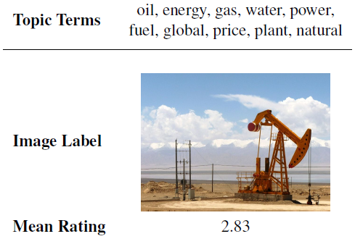
This paper presents a method that can estimate the degree of association between topics and images using a deep neural network
2
MODEL
Labeling Topics with Images using a Neural Network, 2017, ECIR
Notes:
However, in order to do this, they required external resources (two search APIs, one of which is no longer publicly available), limiting the general-purpose utility of the
method

Slide 17
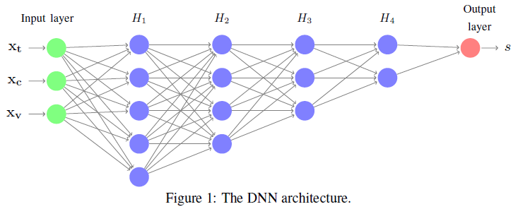

2
MODEL
the mean vectors of words in topics
the mean vectors of words in image captions
the output of the publicly available 16-layer VGG-net trained over the ImageNet dataset
Labeling Topics with Images using a Neural Network, 2017, ECIR
Notes:
However, in order to do this, they required external resources (two search APIs, one of which is no longer publicly available), limiting the general-purpose utility of the
method

Slide 18
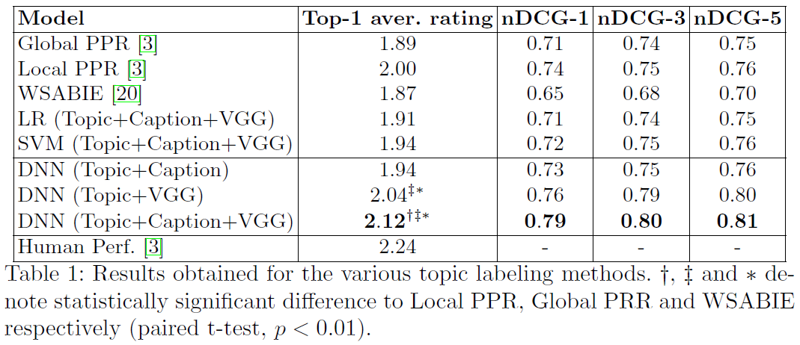
Experiments
20 candidate images per topic by using Google
2
MODEL
Labeling Topics with Images using a Neural Network, 2017, ECIR

Slide 19
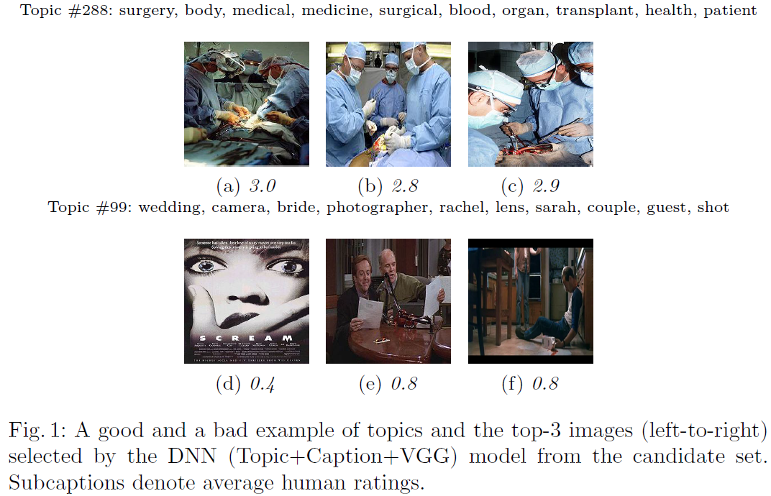
Experiments
2
MODEL
Labeling Topics with Images using a Neural Network, 2017, ECIR
Notes:
The labels selected for the topic #288 are all very relevant to a Surgical operation. On the other hand, the images selected for topic #99 are irrelevant to Wedding photography.
借鉴CV的研究成果；网络结构的优化；现在是判别式，能不能考虑生成式，图片领域已有很多GAN这方面的研究，当然那就需要数据支撑

Slide 20
3
1
A Knowledge-based Topic Modeling Approach for Automatic Topic Labeling
2017 IJACSA
20

Slide 21
This paper have incorporated ontology concepts with statistical topic modeling in a unified framework
The best topic labels are selected with respect to the semantic similarity of the concepts and their ontological categorizations
2
MODEL
A Knowledge-based Topic Modeling Approach for Automatic Topic Labeling

Slide 22
Step 1
The KB-LDA Topic Model
2
MODEL
is the set of concepts from DBpedia
A Knowledge-based Topic Modeling Approach for Automatic Topic Labeling
Notes:
However, in order to do this, they required external resources (two search APIs, one of which is no longer publicly available), limiting the general-purpose utility of the
method

Slide 23
Step 1
Inference using Gibbs Sampling
multinomial distribution of topics for document
multinomial distribution of concepts for topic
multinomial distribution of words for concept
2
MODEL
A Knowledge-based Topic Modeling Approach for Automatic Topic Labeling
Notes:
However, in order to do this, they required external resources (two search APIs, one of which is no longer publicly available), limiting the general-purpose utility of the
method

Slide 24
Step 2 Concept-based topic labeling
Semantic Graph Construction
Edges are connected by a relationship in the ontology (DBpedia)
2
MODEL
A Knowledge-based Topic Modeling Approach for Automatic Topic Labeling

Slide 25
Step 2 Concept-based topic labeling
Semantic Graph Construction
Hyperlink-Induced Topic Search algorithm to find core concepts
2
MODEL
A Knowledge-based Topic Modeling Approach for Automatic Topic Labeling

Slide 26
Step 2 Concept-based topic labeling
Candidate labels generation
A set of ontology classes of core concepts (their categories in DBpedia)
2
MODEL
A Knowledge-based Topic Modeling Approach for Automatic Topic Labeling

Slide 27
Step 2 Concept-based topic labeling
Semantic Relevance Scoring Function
1. the label should be more specific to the core concepts
2. the label should cover the highest number of core concepts
2
MODEL
A Knowledge-based Topic Modeling Approach for Automatic Topic Labeling

Slide 28
Experiments
2
MODEL
A Knowledge-based Topic Modeling Approach for Automatic Topic Labeling

Slide 29
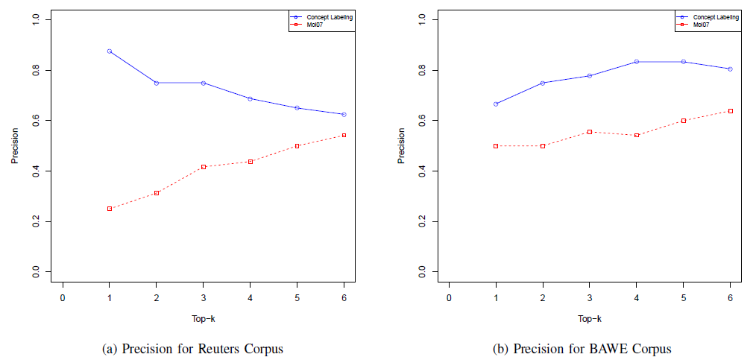
Experiments
Comparison of the systems using human evaluation
2
MODEL
A Knowledge-based Topic Modeling Approach for Automatic Topic Labeling

Slide 30
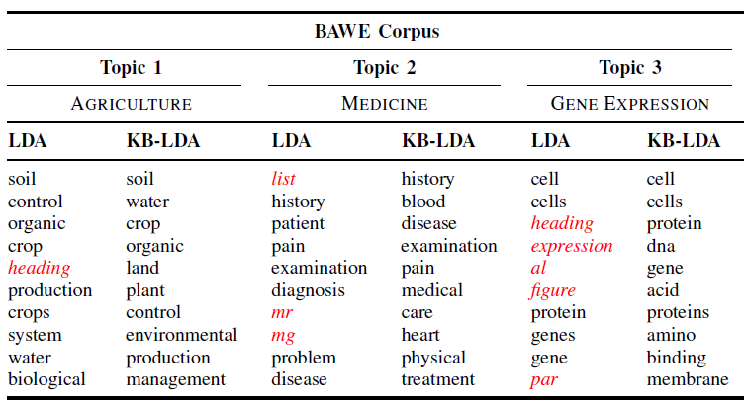

Experiments
2
MODEL
A Knowledge-based Topic Modeling Approach for Automatic Topic Labeling
Notes:
概率图；主题模型一系列加圈方法；参数估计方法

Slide 31
4
Labeling of Topic Models Using Text Summaries
2017 ACL
31

Slide 32
1
Motivation
Providing more contextual information and using long text descriptions to represent the topics
the top terms for a discovered topic:
fire miles area north southern people coast
homes south damage northern river state friday
central water rain high california weather
Labeling of Topic Models Using Text Summaries, ACL, 2017

Slide 33
1
Motivation
Providing more contextual information and using long text descriptions to represent the topics
Showers and thunderstorms developed in parched areas of the southeast , from western north carolina into south central alabama , north central and northeast texas and the central and southern gulf coast . …
The quake was felt over a large area , extending from santa rosa , about 60 miles north of san francisco , to the santa cruz area 70 miles to the south ….
Labeling of Topic Models Using Text Summaries, ACL, 2017

Slide 34
2
Contributions
We are the first to invesitage using text summaries for topic labeling
We propose a summarization algorithm based on submodular optimization to extract summaries with both high relevance, coverage and discrimination for all topics
Automatic and manual analysis reveals the usefulness and advantages
Labeling of Topic Models Using Text Summaries, ACL, 2017

Slide 35

3
Methods
Candidate Sentence Selection
Computing the Kullback-Leibler (KL) divergence between the word distributions of the topic θ and each sentence s in the whole document collection
TW - top 500 words in topic
SW - words in sentences
Labeling of Topic Models Using Text Summaries, ACL, 2017

Slide 36


3
Methods
Topic Summary Extraction
Finding an optimal summary from all possible summaries E by maximizing a score function
V - candidate sentence set
Labeling of Topic Models Using Text Summaries, ACL, 2017

Slide 37


3
Methods
Topic Summary Extraction
Relevance Function
Coverage Function
Labeling of Topic Models Using Text Summaries, ACL, 2017

Slide 38

3
Methods
Topic Summary Extraction
Discrimination Function
Greedy Selection
Labeling of Topic Models Using Text Summaries, ACL, 2017

Slide 39
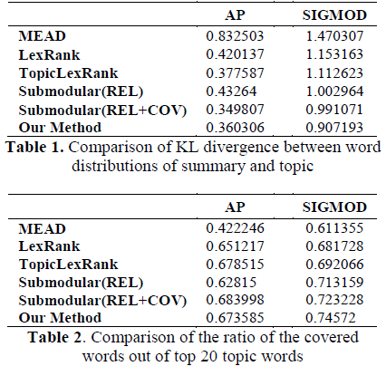
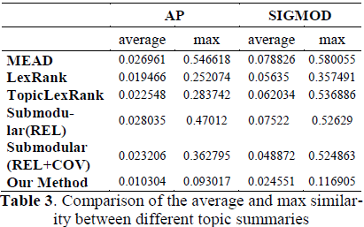
4
Experiments
Labeling of Topic Models Using Text Summaries, ACL, 2017

Slide 40
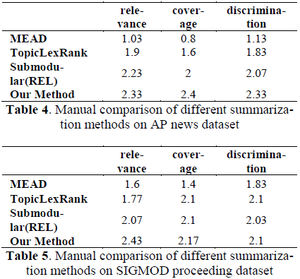
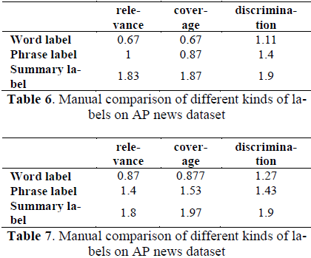
4
Experiments
Labeling of Topic Models Using Text Summaries, ACL, 2017

Slide 41
5
My thoughts
Multimodal topic labelling --- make use of all the three kinds of labels together to improve the users’ experience
Generating methods for automatic labeling
Practical application in short text
Labeling of Topic Models Using Text Summaries, ACL, 2017

